Slide 1
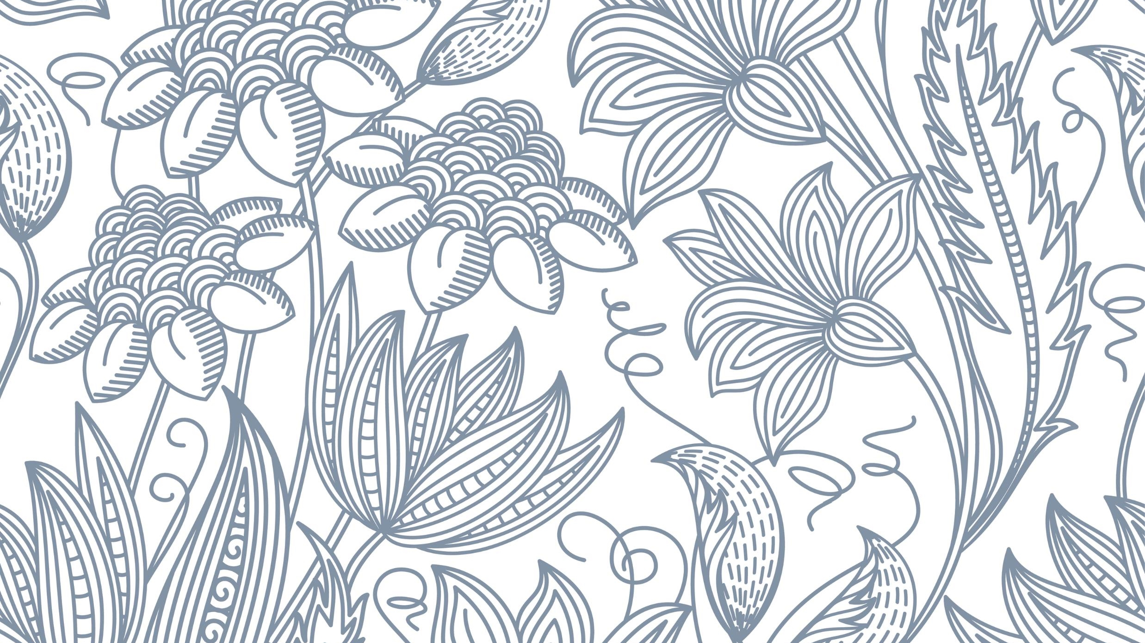
Get Familiar With my state
Jammu and Kashmir

Slide 2
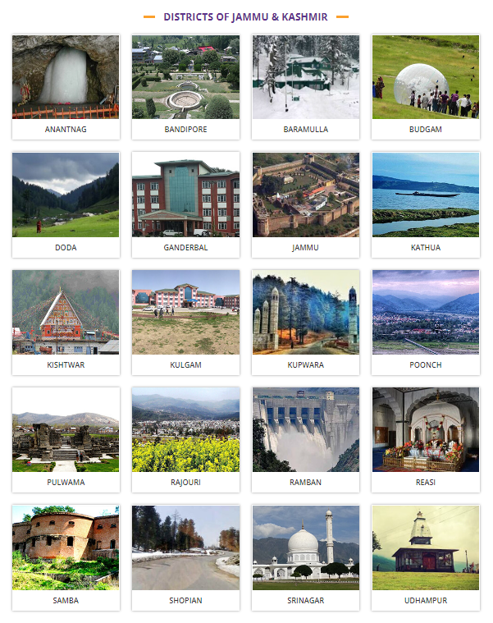

Slide 3
List of languages of Jammu and Kashmir:
Kashmiri
Dogri
Urdu
Punjabi
Gojri (Gujari)
Pahari
Bhaderwahi
Balti
Shina
Ladakhi
Khowar (Chitrali)
Wakhi
These languages collectively represent the rich linguistic diversity of the Jammu and Kashmir region.

Slide 4
District | Languages Spoken
Anantnag | Kashmiri, Urdu, Pahari
Bandipora | Kashmiri, Urdu
Baramulla | Kashmiri, Urdu, Pahari
Budgam | Kashmiri, Urdu
Doda | Kashmiri, Bhadarwahi, Urdu
Ganderbal | Kashmiri, Urdu
Jammu | Dogri, Hindi, Punjabi, Urdu
Kathua | Dogri, Hindi, Punjabi, Urdu
Kishtwar | Kishtwari, Urdu

Slide 5
District | Languages Spoken
Kulgam | Kashmiri, Urdu, Pahari
Kupwara | Kashmiri, Urdu
Leh | Ladakhi, Balti, Urdu
Poonch | Pahari, Gojri, Kashmiri, Urdu
Pulwama | Kashmiri, Urdu
Rajouri | Pahari, Gojri, Dogri, Punjabi, Hindi, Urdu
Ramban | Kashmiri, Bhadarwahi, Gojri, Urdu
Reasi | Dogri, Hindi, Urdu
Samba | Dogri, Hindi, Punjabi, Urdu

Slide 6
District | Languages Spoken
Shopian | Kashmiri, Urdu
Srinagar | Kashmiri, Urdu, Hindi, English
Udhampur | Dogri, Hindi, Urdu

Slide 7
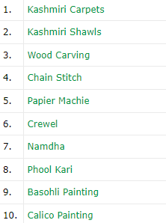
Handicraft Products:
Source: https://www.jkhandicrafts.com/products.htm

Slide 8
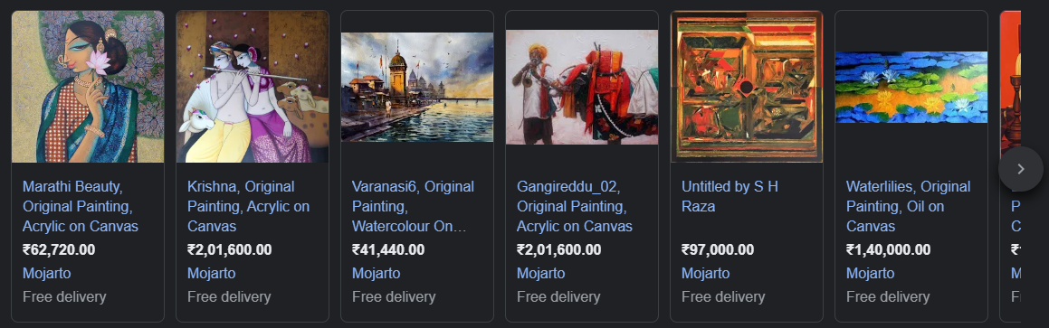
Basohli Paintings:

Slide 9
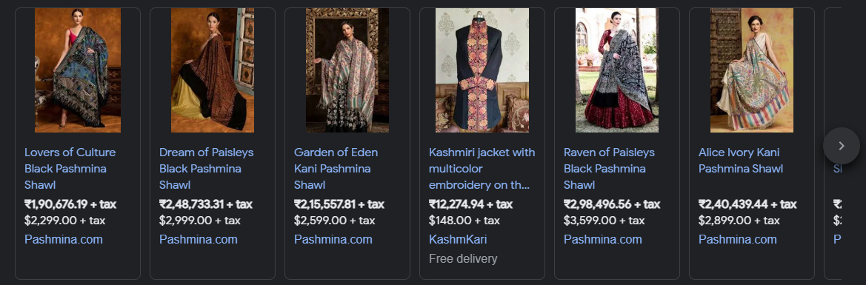
Kashmiri Shawls :

Slide 10
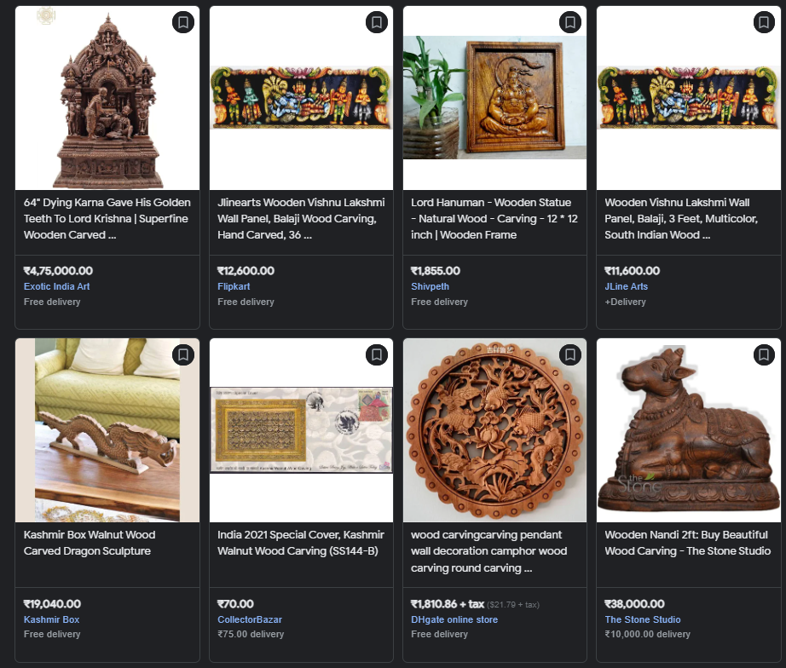
Wood Carvings:

Slide 11
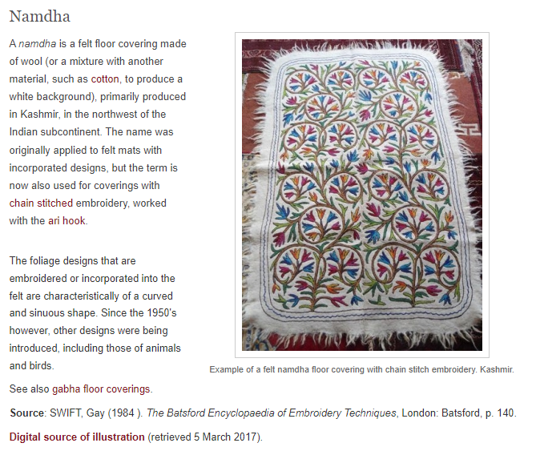
Namdha:

Slide 12
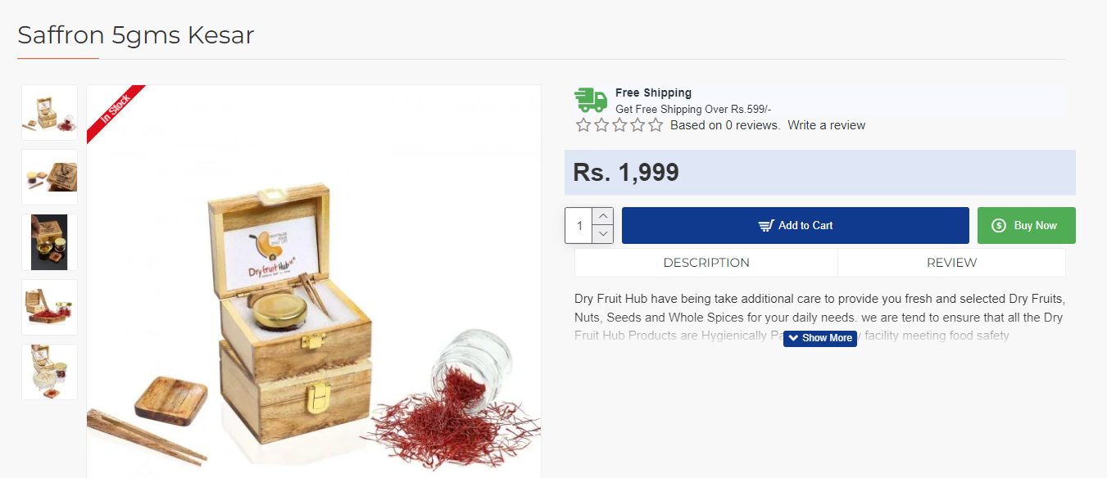
Kesar:

Slide 13


Slide 14
